Slide 1
IT AIN’T WHAT YOU DO TO DATA…
IT’S WHAT YOU DO WITH IT
Edd Dumbill • @edd
edd@svds.com • svds.com/StrataUK2015

Slide 2




































Edd Dumbill
VP Strategy

Slide 3
Prioritize for highest business value when using emerging technology
Design with outcomes in mind
Be agile: deliver initial results quickly, then adapt and iterate
Collaborate constantly with our customers and partners
Our Philosophy

Slide 4
How we used to think about data
Why big data is a big deal
Data strategy
New platforms have new characteristics
Data value chain
Building for experiments
overview

Slide 5
“Data strategy is not for the faint of heart”
¹ Creating an Enterprise Data Strategy; Wayne Eckerson - http://www.slideshare.net/Dataversity/creating-an-enterprise-data-strategy

Slide 6
IS There an Alternative?
In today’s competitive environment, data must serve the strategic imperatives of a business—the key aspirations that define the future vision for an organization.
A modern data strategy is a roadmap to enable data-driven decision-making and applications that helps an enterprise achieve its strategic imperatives.
An effective data strategy helps an enterprise make technology choices, grounded in business priorities, to get the most value from their data.

Slide 7
CONNECTING TECHNOLOGY AND BUSINESS VALUE
If you find that you can’t articulate how the cost of your data systems relates to the benefits to your business, or if you can’t articulate how your technology philosophy enables your business aspirations, then your organization would almost certainly benefit from data strategy.
Notes:
Fundamentally believe that value from data strategy is a from blending business and technology
If the linkage between the two isn’t clear – it’s time to revisit your approach to data

Slide 8
Articulating the business impact of data & Technology
POP QUIZ
Do you feel like the technology leadership in your organization prioritizes investments to meet the ambitions of the business?
Can your organization clearly articulate the business impact of the data and technology investments it makes?

Slide 9




DIGITAL NERVOUS SYSTEM

Slide 10

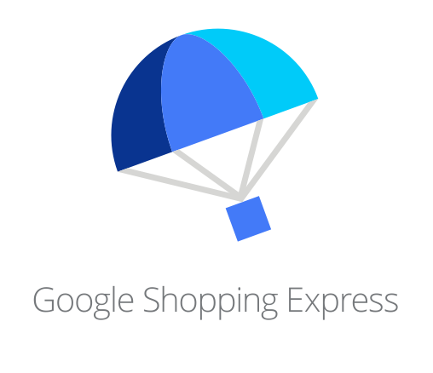








SILICON VALLEY’S DATA MACHINE

Slide 11
It’s time to redefine what “data strategy” means

Slide 12




CONVENTIONAL DATA STRATEGY
“WHAT YOU DO TO DATA”
CLEAN
VALIDATE
CONTROL
PROTECT

Slide 13
Conventional Wisdom: 10 THINGS A DATA STRATEGY SHOULD INCLUDE²
What data should be collected?
How long should data be kept?
Where should the data be stored?
How will data privacy and security be managed?
From where can data be accessed?
What data can be displayed?
What level of detail should be retained?
Who is responsible for the data (governance)?
How is data integrated?
How will data be distributed? (virtualization?)
² 10 Key Elements of your Data Strategy; Mike Schiff – http://www.tdwi.org/Articles/2012/01/17/10-Elements-Data-Strategy.aspx?Page=1

Slide 14


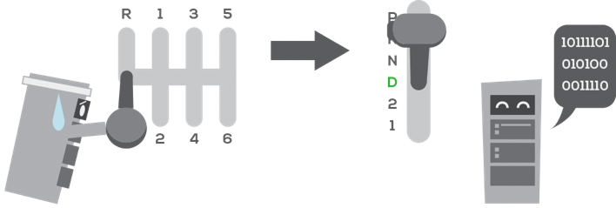
MODERN DATA STRATEGY
“WHAT YOU DO WITH DATA”
ATTRACT NEW CUSTOMERS
TARGET VIP CUSTOMERS
AUTOMATE

Slide 15
New orthodoxy
4 PRINCIPLES OF A SUCCESSFUL DATA STRATEGY³
How does data generate value?
What are our critical data assets?
What is our data ecosystem?
How do we govern data?
³ The 4 Principles of a Successful Data Strategy; Paul Barth - http://www.cioupdate.com/insights/article.php/11049_3936706_2/The-4-Principles-of-a-Successful-Data-Strategy.htm

Slide 16
BEGIN WITH THE BUSINESS
First understand what drives your business
Then make the leap from strategy to tactics
@Technologists: This can’t be done without the business people in the room
@BusinessLeaders: This can’t be done without the technologists in the room
Notes:
Start of any new data strategy begins with the business
What’s driving your business? (e.g., enter a new market, grow a business, optimize operations)
These are the true goals of your strategy and data is the means to that end
EXAMPLE:
Connect with pet parents in a personalized way
Grow most valuable customers
From there we have to start breaking it down
Make the leap from strategy to tactics - *how* will you achieve your aspirations? (e.g., predict demand in a region, personalize customer experience, automate a business process)
Expand your imagination – think beyond just how you’re using data today
Yes – you’re bound by the art of the possible, but at this stage you’re really looking for are the problems the business needs to solve
EXAMPLE:
Capture and use customer and pet data
Deliver personalized recommendations and marketing offers based on prior purchases, preferences, and unique needs
Track and share real-time store inventory
Some of these imperatives and objectives will be addressable with data – others will not
Working together is absolutely required
Common consensus on the drivers, the priorities, the basis for the strategy is essential
Shared creation = sense of shared ownership
We’ve found: having these conversations together leads to a-ha moments
Often times the first time the two groups are coming together to have these types of conversations
???INTERACTION: HOW EASY IS IT TO CROSS THE AISLES IN YOUR ORGANIZATION?

Slide 17
We have different aims, and different capabilities

Slide 19
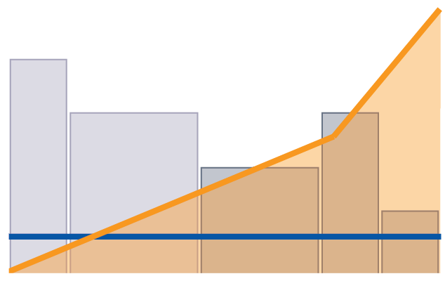
UP vs OUT
Scale-up cost
Different use cases put different demands on the data infrastructure.
Increasing cost per unit of capability from scale-up architectures causes rationing of resources. Only the most valuable use cases are pursued.
UC1
US Dollars
UC2
UC4
UC3
UC5
Scale-out cost
Data Resource Usage

Slide 20
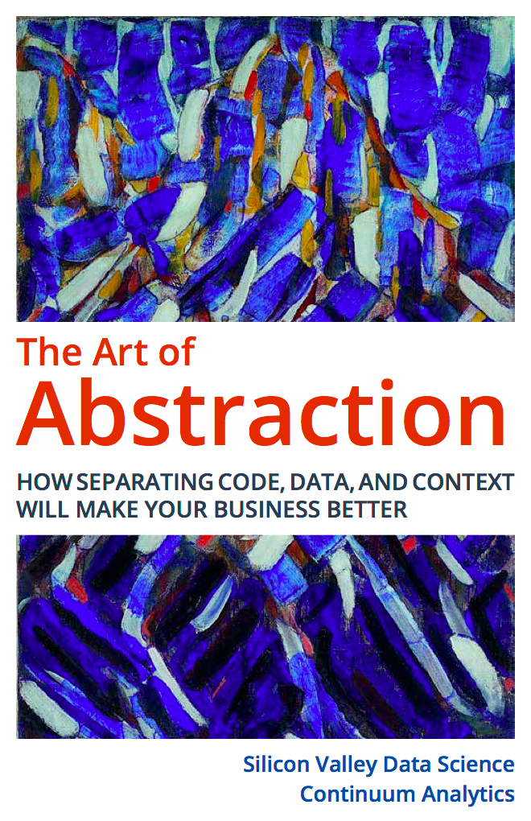
DELAYING DECISIONS…
The Art of Abstraction
svds.com/abstraction
Schema on read

Slide 21
THE DATA LAKE
A scalable, accessible repository of data
(in its natural or processed state)

Slide 22







THE DATA VALUE CHAIN
DRAW VALUE FROM YOUR STRATEGIC DATA ASSETS
Discover Ingest Process Persist Integrate Analyze Expose

Slide 23
How do you think about building with data?

Slide 24





OUR METHOD FOR DATA STRATEGY
IDENTIFY STRATEGIC IMPERATIVES
DEFINE BUSINESS OBJECTIVES
DEFINE DATA
REQUIREMENTS
IDENTIFY GAPS
IN CURRENT SYSTEMS & TECHNOLOGY
MAP OBJECTIVES AND REQUIREMENTS TO
USE CASES
RATIONALIZE USE CASES INTO WORKLOADS
PROJECT ACTION PLAN & ROADMAP

Slide 25
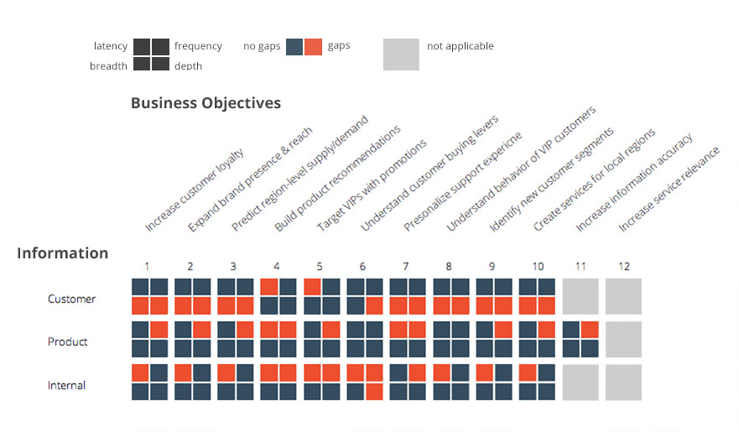
illustrative
DATA CONSTRAINTS
Notes:
As part of our analysis, we have ways of visualizing some of the complex, multi-dimensional information necessary to understand your business
For instance, Gap Analysis on your data requirements along different dimensions (latency, frequency, breadth, depth)
Look at your various sources of data – compare to your business objectives
Read this in many different ways to spot trends – box-by-box, row-by-row, column-by-column
box-by-box (e.g., you have a latency issue with customer data on your VIPs)
Row-by-row (e.g., with the exception of VIPs, you don’t have data broad or deep enough to accomplish most of your objectives)
Column-by-column (e.g., you want real-time product recommendations, but you perhaps batch processes are creating data latency problems that prevent you from doing that)
Information Categories:
Customer: Data coming from the customer directly.
Surveys, Voluntary feedback (via email, phone calls, etc.), Customer service call logs, Customer profile/account, Explicit ratings on products
Product: Data coming from the product. Depending on how the product is defined, this could be data coming from partners and 3rd-parties.
Metadata about the product, Performance-related information/logs (ex: if the product is an app, information on when the app is down)
Internal: Data owned and/or derived internally.
Transaction information, Success metrics and KPIs, Customer usage logs
How to read the chart
Box by box: illustrates the gap in one data requirement for one information category related to one objective – example: gap in data requirement for “depth” from customer information for the objective “Increase customer loyalty” – This is because not enough information is collected from the customer over time to measure loyalty.
Column by column: illustrates the impact gaps in data requirements have on one business objective. For example, the business objective for “build product recommendations” does not meet the requirement for “latency” for any category of information sources. Product recommendations are a real-time application that require near immediate data collection.
Row by row: illustrates the opportunity closing the gaps in data requirements for one data source has across the business objectives. “Product” data is collect on an inconsistent basis. Each product sends information at a different frequency. Collecting product information on a consistent and more frequent manner will close the gaps in frequency across almost all business objectives.

Slide 26
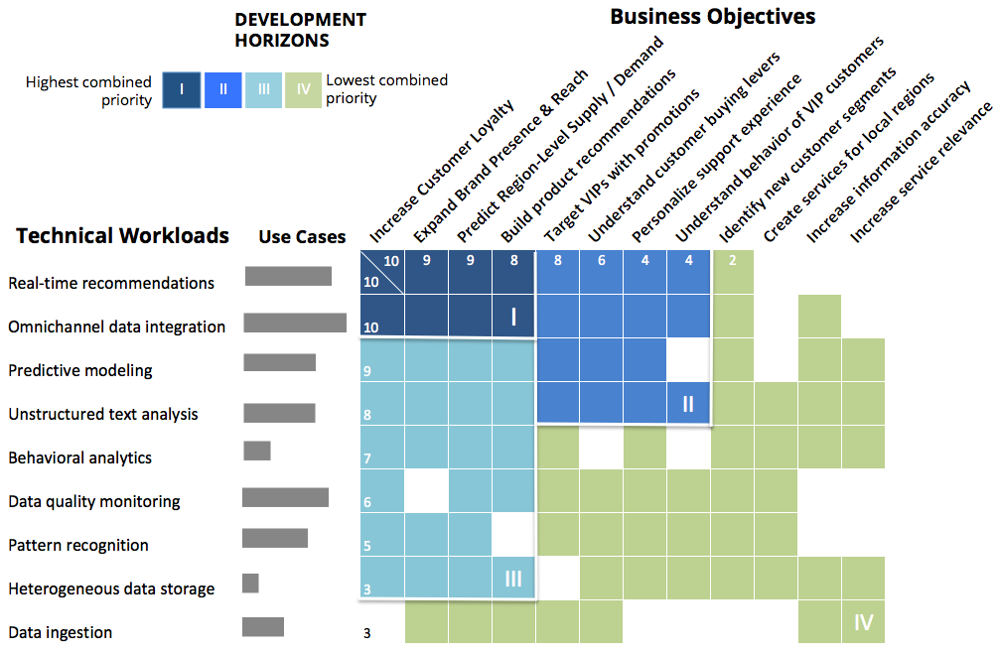
illustrative Development Horizons
Notes:
Recall: Goal is to map business objectives to series of repeatable technical workloads
Identify what Technical Capabilities are Most Critical to Strategic Ambitions
From these we can extract your horizons of development
Columns: list of objectives, sorted by priority as determined by your leaders
Rows: list of workloads, sorted by value (# and priority of use cases they impact)
Use cases: bars near the left show # of use cases per workload
Analysis allows us to look at groupings that emerge, shown in different colors
E.g., upper left dark blue region shows the most important technical capabilities, applied to the most important objectives

Slide 27


DATA STRATEGY AND THE CDO
Julie Steele & Scott Kurth
Thursday 13:45
Blenheim Room

Slide 28
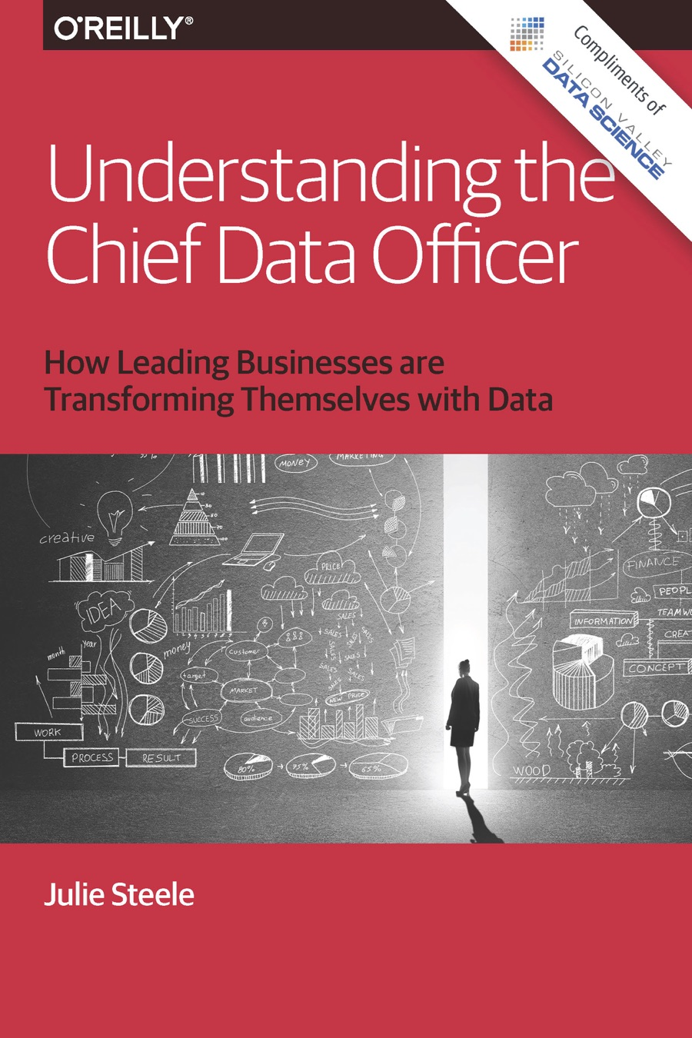
CDO Report
svds.com/cdoreport

Slide 29
We need a different organizational mindset

Slide 30
Make it cheap
  Failure as a feature
  Ask good questions
Make it quick
  Both learning and adaptation
  Enable the feedback loop
Don’t break things
  Make operations a platform for innovation
  APIs, platforms, simulation
BUILD FOR EXPERIMENTS

Slide 31
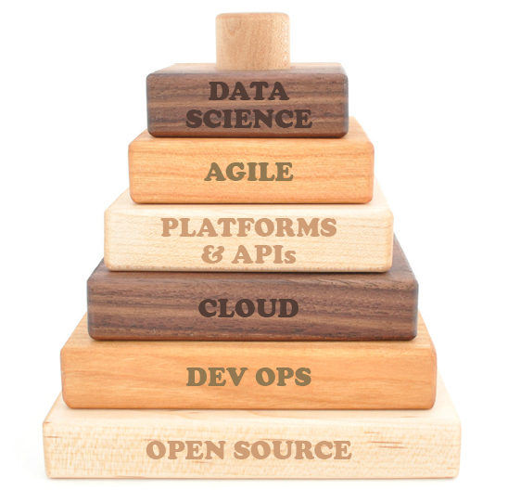
THE EXPERIMENTAL ENTERPRISE
Data science allows us to observe our experiments and respond to the changing environment.
We need to both support investigative work and build a solid layer for production.
The foundation of the experimental enterprise focuses on making infrastructure readily accessible.

Slide 32
BECOME DATA NATIVE
Can only win with situational awareness
New architectures offer new opportunities
Creation of data-driven value requires new approach
Business must lead, and understand the potential of the technology

Slide 33
Edd Dumbill
edd@svds.com
@edd
@SVDataScience
Yes, we’re hiring!
info@svds.com
Want these slides? Go to:
svds.com/StrataUK2015

